Slide 1

Capstone Project On BOOK RECOMMENDATION SYSTEM

Slide 2
Problem Statement
When we want to read a new book we generally ask our friends or classmates or may search all the books available in a library (as if we can). After all asking and searching, we may still not find any book of our preference as not everyone has the same interests. For such situations, we need a system which takes our choices into consideration and suggests to us some good books.
A recommendation system broadly recommends items to the user best suited to their tastes and traits. It uses the user's previous data and other user's data to give new recommendations.

Slide 3

Contents
Data Description
Recommendation Models
Conclusion
Challenges

Slide 4
Data Description
The Book-Crossing dataset comprises 3 files.
● Users : Contains the users. Note that user IDs (User-ID) have been anonymized and map to integers. Demographic data is provided (Location, Age) if available. Otherwise, these fields contain NULL values.
● Books : Books are identified by their respective ISBN. Invalid ISBNs have already been removed from the dataset. Moreover, some content-based information is given (Book-Title, Book-Author, Year-Of-Publication, Publisher), obtained from Amazon Web Services. Note that in the case of several authors, only the first is provided. URLs linking to cover images are also given, appearing in three different flavors (Image-URL-S, Image-URL-M, Image-URL-L), i.e., small, medium, large. These URLs point to the Amazon website.
● Ratings : Contains the book rating information. Ratings (Book-Rating) are either explicit, expressed on a scale from 1-10 (higher values denoting higher appreciation), or implicit, expressed by 0.

Slide 5
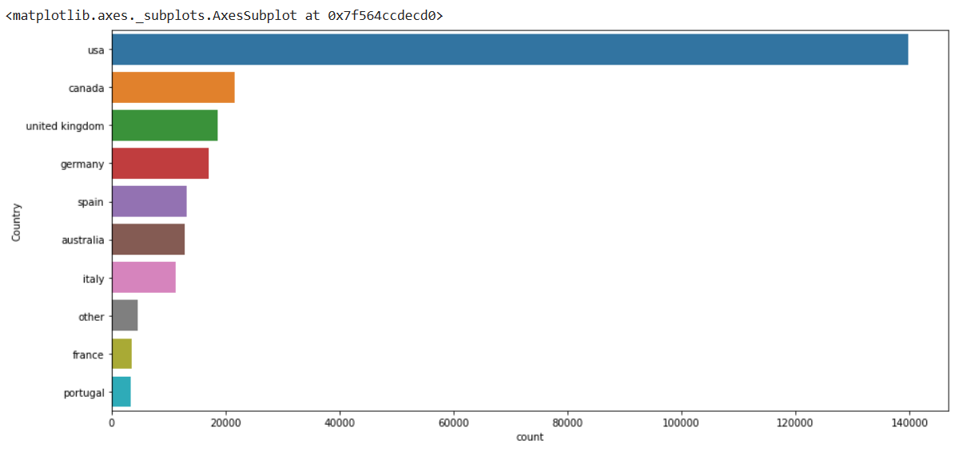
Country’s with number of Book’s published
The most number of books published is in USA followed by Canada and United Kingdom.

Slide 6
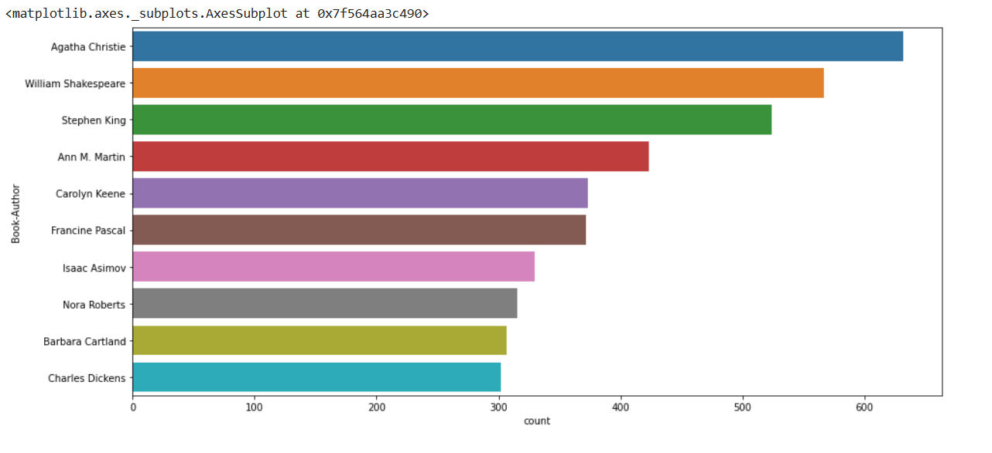
Top 10 Authors which have written the most books.:-
Fvmkd;

Slide 7
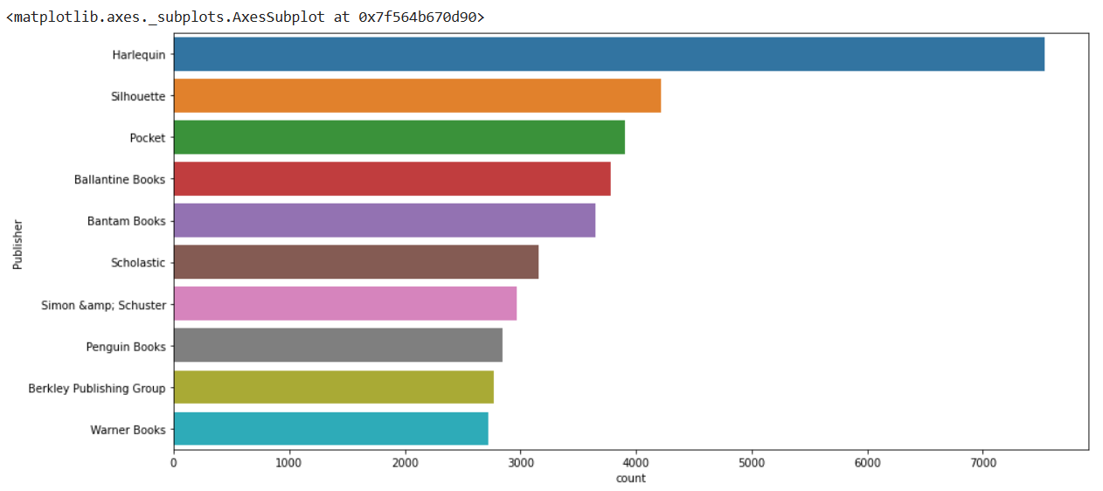
Top 10 Publisher which have published the most books.:-

Slide 8
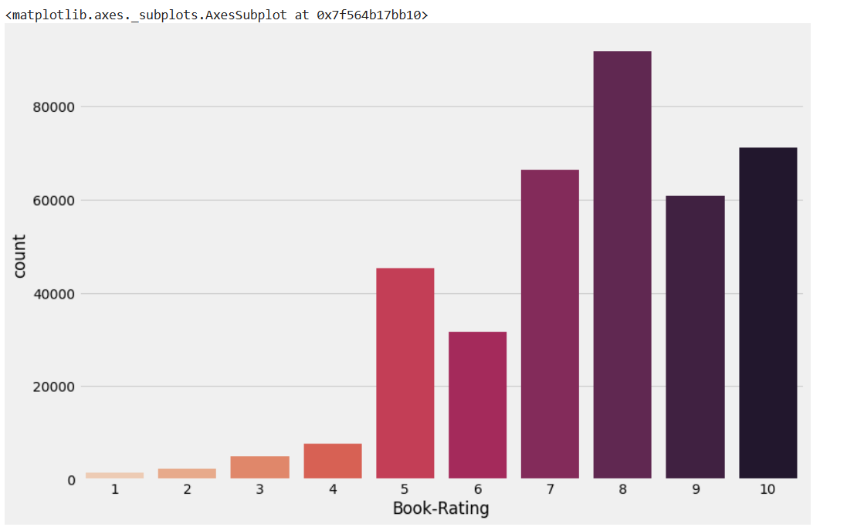
BOOK-RATING

Slide 9
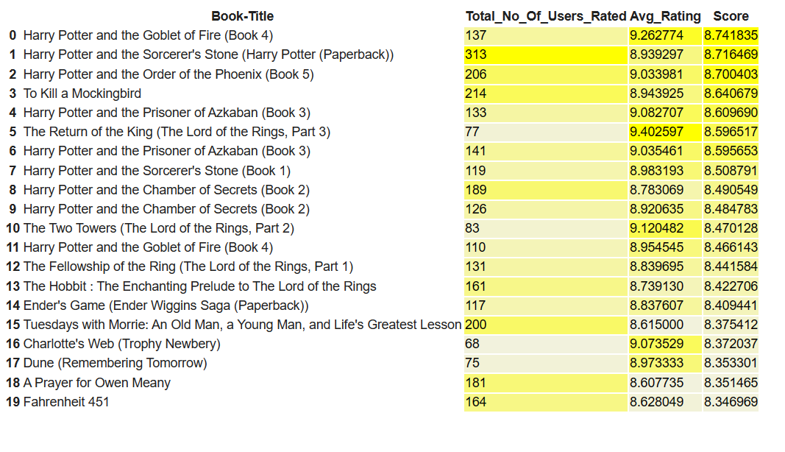
TOP 20 BOOKS

Slide 10
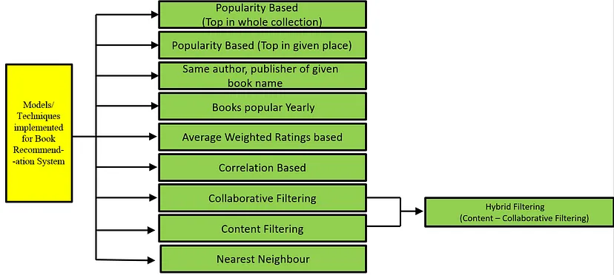
Recommendation Models
We started building some basic recommendation systems and then implemented collaborative and content-based filtering methods as well.

Slide 11
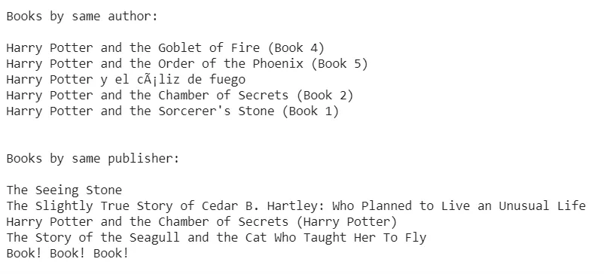
Books by the same author, publisher of the given book name
For this model, we have sorted the books by rating for the same author and same publisher of the given book and recommended top n books.

Slide 12
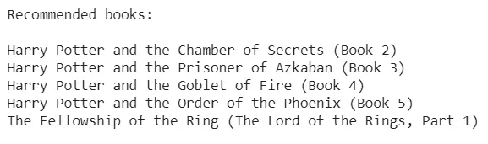
Nearest Neighbours Based
To train the Nearest Neighbours model, we have created a compressed sparse row matrix taking ratings of each Book by each User individually. This matrix is used to train the Nearest Neighbours model and then to find n nearest neighbors using the cosine similarity metric.

Slide 13
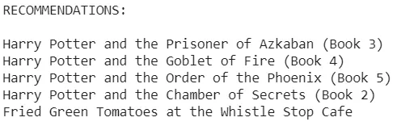
Collaborative Filtering (User-Item Filtering)
Collaborative Filtering Recommendation System works by considering user ratings and finds cosine similarities in ratings by several users to recommend books. To implement this, we took only those books' data that have at least 50 ratings in all (because of limited resources).

Slide 14
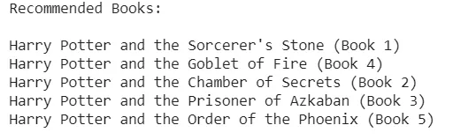
Content-Based Filtering
We have implemented a content-based recommendation system that recommends books by calculating similarities in Book Titles. For this, TF-IDF feature vectors are created for unigrams and bigrams of Book-Titles where only those books' data has been considered which are having at least 80 ratings (because of limited resources).

Slide 15
Model Based Collaborative Filtering Recommender
The goal of the recommender system is to predict user preference for a set of items based on the past experience. Two the most popular approaches are Content-Based and Collaborative Filtering. Collaborative filtering is a technique used by websites like Amazon, YouTube, and Netflix. It filters out items that a user might like on the basis of reactions of similar users. There are two categories of collaborative filtering algorithms: memory based and model based.
Model based approach involves building machine learning algorithms to predict user's ratings. They involve dimensionality reduction methods that reduce high dimensional matrix containing abundant number of missing values with a much smaller matrix in lower-dimensional space.

Slide 16
For the given dataset much better results can be obtained with SVD approach - both in terms of accuracy and training testing time.
Grid Search Cross Validation computes accuracy metrics for an algorithm on various combinations of parameters, over a cross-validation procedure.
Regarding the majority of parameters, the default setting is the most optimal one. The improvement obtained with Grid Search is very small.

Slide 17

Conclusion
In EDA, the Top-10 most rated books were essentially novels. Books like The Lovely Bone and The Secret Life of Bees were very well perceived.
Majority of the readers were of the age bracket 20-35 and most of them came from North American and European countries namely USA, Canada, UK, Germany and Spain.

Slide 18
If we look at the ratings distribution, most of the books have high ratings with maximum books being rated 8. Ratings below 5 are few in number.
Author with the most books was Agatha Christie, William Shakespeare and Stephen King.
For modelling, it was observed that for model based collaborative filtering SVD technique worked way better than NMF with lower Mean Absolute Error (MAE) .
Amongst the memory based approach, item-item CF performed better than user-user CF because of lower computation

Slide 19

CHALLENGE
Data set was not easy to understand and manipulate.
Challenging to identify and fit the right model for tha data due to the problem is Binary nature.
Identifying the key factors and deciding best fit models after getting results of models.
We were unable to do visualization and fitting of model easily due to bulk and running models were taking lot of time.

Slide 20



